Slide 1
SENG 438 Software Testing, Reliability & Quality
Chapter 4: Black-box Testing
Department of Electrical & Computer Engineering, University of Calgary
B.H. Far （far@ucalgary.ca）
http://people.ucalgary.ca/~far

Slide 2
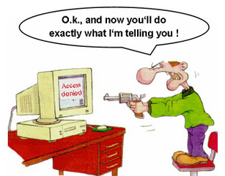
Last Week
Unit testing
JUnit can help with automation of test execution
We’ve learnt to write JUnit tests
But how do we design those JUnit tests?
Black-box
White-box
Goal is completeness of tests
Our focus in this Chapter

Slide 3
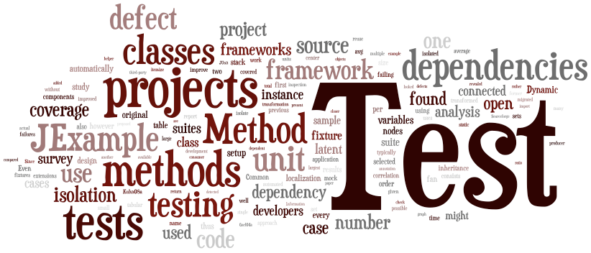
Contents
The need for systematic test case generation techniques
Equivalence class partitioning techniques
Boundary value analysis
Decision tables
Combinatorial testing
Profile based testing

Slide 4
Review: Black- vs. White-box
Black-box testing
Testing, either functional or non-functional, without reference to the internal structure of the component or system
Synonyms: specification-based testing
White-box testing
Procedure to derive and/or select test cases based on an analysis of the internal structure of a component or system
Synonyms: structural test design technique
Notes:
Exhaustive testing is impractical
We need techniques to identify test cases with the most likelihood of finding a defect out of the possible many.

Slide 5
Review: Black- vs. White-box
The techniques are complementary
System
Specification
Implementation
Missing functionality: Cannot be revealed by white-box techniques
Unexpected functionality: Cannot be revealed by black-box techniques

Slide 6
Review: Black- vs. White-box
BB testing applies at all granularity levels:
Unit (from module interface spec)
Integration (from API or subsystem spec)
System (from system requirements spec)
Regression (from system requirements + bug history)
WB testing applies to relatively small parts of a system:
Unit
Integration

Slide 7
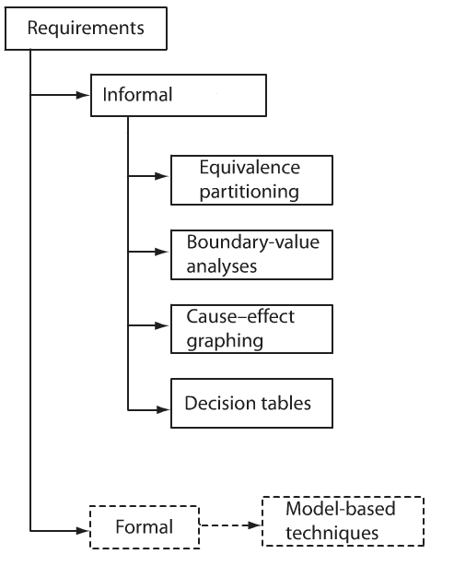
BB Test Generation
From system requirements
Here our focus is on informal approaches
Combinatorial technique
will be discussed later in
this chapter

Slide 8
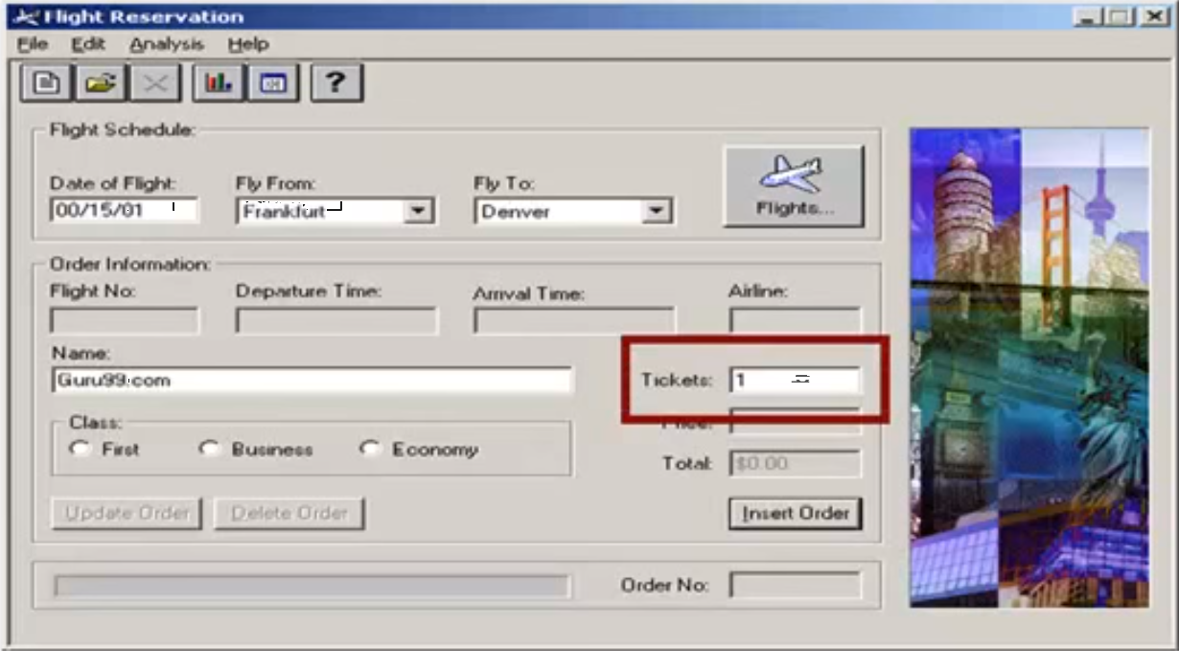
Testing Flight Reservation App
Between 1 and 10 tickets can be purchased (booked) in one transaction
Value 11 to 99 are considered invalid for reservation and error message will appear, “Up to 10 tickets may be ordered at one time”
How many test
cases we need?

Slide 9
Testing Flight Reservation App
We would like to have a sense of complete testing based on specification of a unit
We would like to avoid test redundancy (having several copies of test cases testing the same functionality)
Our first solution is using Equivalence Class Partitioning
Inputs in an “equivalence class” are assumed to be “treated the same” by the system …
This is the key to the definition of good equivalence classes
Notes:
9
Inputs in an equivalence class are assumed to be “treated the same” by the system … this is the key to the definition of good equivalence classes

Slide 10
Equivalence Class Testing (ECT)
You divide input set into partition that can be considered the same
Equivalence classes: partitions of the input space in such a way that input data have the same effect on the SUT
Note the difference between “same behavior” and “same output”
Entire input set is covered: Completeness
Disjoint classes: to avoid redundancy
Test cases: one element of each equivalence class
But equivalence classes have to be chosen wisely
Guessing the likely system behavior is needed

Slide 11
Equivalence Classes
A group of tests cases are “equivalent” if:
They all test the same unit (usually a method or a class)
If one test case can catch a bug, the others will probably do
If one test case does not catch a bug, the others probably will not do
They involve the same input variables
They all affect the same output variables

Slide 12
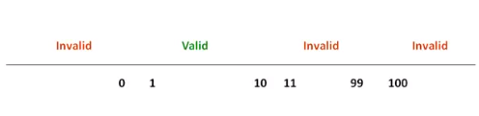
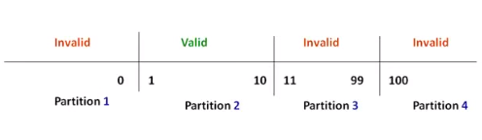
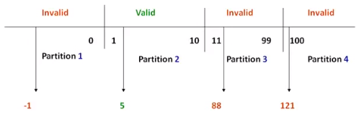
Partitioning Example 1
Step 1
Analyzing
Step 2
Partitioning
Step 3
Creating test case(s)

Slide 13
Equivalence Class Testing
Two trivial partitions
The entire set of inputs to any application can be divided into at least two subsets:
One containing all the Expected or legal inputs (E)
The other containing all Unexpected (illegal) inputs (U)
Each of the two subsets, can be further subdivided into subsets on which the application is required to behave differently (e.g., E1, E2, E3, and U1, U2)

Slide 14
Partitioning Example 2
Example: abs(x)
Equivalence classes are partitions of the input set in which input data result in the same behavior of the program
x>=0 : abs(x) = x
x<0 : abs(x) = -x
EC1
-ve
EC2
+ve
Note: Unexpected (illegal) inputs (U) set may be much larger than the expected set, e.g. non-numbers, symbols, etc.
Notes:
14
Inputs in an equivalence class are assumed to be “treated the same” by the system … this is the key to the definition of good equivalence classes

Slide 15
Partitioning Example 3
Consider an application that requires two integer inputs x and y (as its input)
Each of these inputs is expected to lie in the following ranges: 3≤x≤7 and 5≤y≤9
For one-dimensional partitioning, we apply the partitioning guidelines to x and y individually/independently
This leads to the following six equivalence classes
U1: x<3
E1: 3≤x≤7
U2: x>7
y ignored
U3: y<5
E2: 5≤y≤9
U4: y>9
x ignored
Nine possible combinations

Slide 16
Partitioning Example 3 (cont’d)
Multi-dimensional partitioning
Consider the input domain to be the Cartesian product x*y
Multi-dimensional partitioning of 3≤x≤7 and 5≤y≤9 leads to 9 equivalence classes
Which one is the legal input sub-space?
U1: x<3, y<5
U2: x<3, 5≤y≤9
U3: x<3, y>9
U4: 3≤x≤7, y<5
E1: 3≤x≤7, 5≤y≤9
U5: 3≤x≤7, y>9
U6: x>7, y<5
U7: x>7, 5≤y≤9
U8: x>7, y>9
Expected or legal inputs (E) Unexpected (illegal) inputs (U)

Slide 17

Weak/Strong ECT
For a SUT, suppose there are three input variables from three domains: A, B, C
A = A₁ ∪ A₂ ∪ A₃ ∪ … ∪ A_{m} where a_{i}∈A_{i}
B = B₁ ∪ B₂ ∪ B₃ ∪ … ∪ B_{n} where b_{j}∈B_{j}
C = C₁ ∪ C₂ ∪ C₃ ∪ … ∪ C_{o} where c_{k}∈C_{k}
Weak Equivalence Class Testing (one-dimensional): Choosing one variable value form each equivalence class (one a_{i}, b_{j}, and c_{k}) such that all classes are covered
Strong Equivalence Class Testing (multi-dimensional): based on the Cartesian product of the partition subsets (A×B×C), i.e., testing all interactions of all equivalence classes
A
B
# of test cases? max (|A|, |B|, |C|)
C
# of test cases? |A| x |B| x |C|

Slide 18
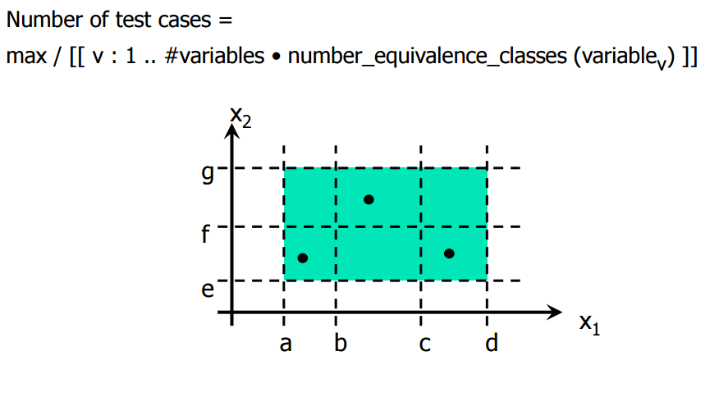
Weak-Normal ECT
A dot is a test case
max (3,2) = 3

Slide 19
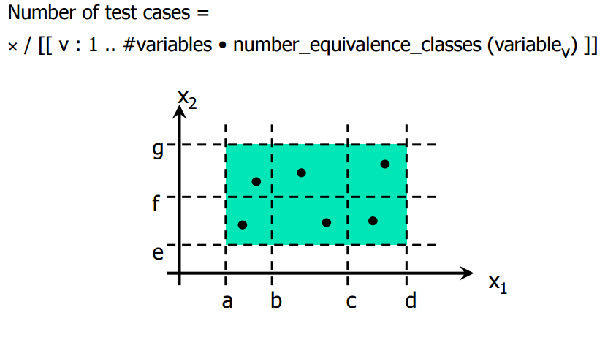
Strong-Normal ECT
(3x2) = 6

Slide 20
Example: Weak ECT
Input variable A has 3 partitions
Input variable B has 4 partitions
Input variable C has 2 partitions
max (3,4,2)=4 test cases are enough for WECTs

Slide 21
Example: Strong ECT
|A| = 3
|B| = 4
|C| = 2
# of test cases
=3x4x2=24

Slide 22
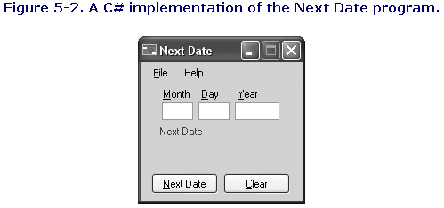
ECT Example: NextDate
NextDate is a function with three variables: month, day, year. It returns the date of the day after the input date
e.g., if we give Feb. 25, 2018 as input, and push “Next Date” button, it will provide the output: Feb. 26, 2018
Simplifying assumption: years between 1824-2024. The app just needs to support that range
Note that proper treatment of leap years makes determining the last day of a month interesting!
02
25
2018
02 26 2018
Notes:
22

Slide 23
ECT Example (cont’d)
Definition of leap years: The Gregorian calendar adds a 29th day to February in all years evenly divisible by 4, except for centennial years (those ending in -00) which are not evenly divisible by 400
Thus 1600, 2000 and 2400 are leap years, but 1700, 1800, 1900, 2100, 2200 and 2300 are not
Only the year 1900 falls in the range 1824-2024
divisible by 4, except for centennial years (those ending in -00)
Leap Years in this range:
1824, 1828, 1832, 1836, 1840, 1844, 1848, 1852, 1856, 1860, 1864, 1868, 1872, 1876, 1880, 1884, 1888, 1892, 1896, 1900
1904, 1908, 1912, 1916, 1920, 1924, 1928, 1932, 1936, 1940, 1944, 1948, 1952, 1956, 1960, 1964, 1968, 1972, 1976, 1980, 1984, 1988, 1992, 1996, 2000, 2004, 2008, 2012, 2016, 2020, 2024
Leap
Year?
Leap
Year?
Notes:
Since a year is 365.2422 days long, leap years are used for the extra data problem. If we declared a leap year every fourth year, there would be a slight error. A year is a leap year if it is divisible by 4, unless this is a century year. Century years are leap years only if they are multiples of 400. 1992, 1996, and 2000 are leap years, while the year 1900 is a common year.
The goal is to gain enough understanding about the problem to “guess” the different treatment inside the system … and then derive equivalence classes. May be discussed with domain experts – domain expertise is key here, though this example is obviously trivial.

Slide 24
ECT Example (cont’d)
NextDate Equivalence Classes
How many variables? 3 How may equivalent classes for each?
M1 = {month: month has 30 days} // Apr., Jun., Sept., Nov.
M2 = {month: month has 31 days} //Jan., Mar., May, Jul., Aug., Oct., Dec.
M3 = {month: month is February}
D1 = {day: 1<= day <= 28}
D2 = {day: day = 29}
D3 = {day: day = 30}
D4 = {day: day = 31}
Y1 = {year: year = 1900}
Y2 = {year: (1824 <= year <= 2024) AND (year != 1900) AND (year mod 4 = 0)}
Y3 = {year: (1824 <= year <= 2024) AND (year mod 4 != 0 )}

Slide 25
ECT Example (cont’d)
NextDate Weak Equivalence Classes
#WECT test cases=maximum partition size (D)
= max(4,3,3)=4
Suggested WECT test suite

Slide 26
ECT Example (cont’d)
NextDate Strong Equivalence Classes
#SECT test cases= partition size (D) x partition size (M) x partition size
(Y) = 3x4x3=36 test cases

Slide 27
ECT Example (cont’d)
Strong ECT is not perfect
Potential issues:
May miss Feb 28 → Solution: make 5 classes for Days
Most “1900” test cases are not interesting
You can ignore that class → only 24 test cases rather than 36
And perhaps add one extra edge case (end of year for 1900) to the suite?
Adding two invalid classes for each variable = 150 equivalence class test cases!

Slide 28
Example 2
We have developed a program that returns the two roots of a quadratic equation ax²+bx+c=0
Java code for this program is given
The roots are calculated as:
Let’s assume that a, b and c can take values between -10 and +10
What are equivalent classes for a, b and c?
What is the number of test cases for
Weak ECT
Strong ECT
class Roots { double root_one, root_two; int num_roots; public roots(double a, double b, double c) { double q; double r; q = b*b - 4*a*c; if (q>0) { // If b^2 > 4ac, there are two distinct roots num_roots = 2; r= (double) Math.sqrt(q) ; root_one = ((0 - b) + r)/(2*a); root_two = ((0 - b) - r)/(2*a); } else if (q==0) { //The equation has one root only num_roots = 1; root_one = (0 - b)/(2*a); root_two = root_one; } else { // The equation has no roots if b^2 <4ac num_roots = 0; root_one = -1; root_two = -1; } } public int num_roots() { return num_roots; } public double first_root() {return root_one; } public double second_root() { return root_two; } }
Bug here?
Notes:
Boundaries: a: -10, 0, 10
b: -10, 10
c: -10, 10

Slide 29
Equivalence Classes /1
Hint (1):
Don’t forget equivalence classes for invalid inputs
Example: For a program that is supposed to accept any number between 1 and 99
There are 4 equivalence classes:
Any number between 1 and 99 (valid)
Any number less than 1 (including zero and negative numbers) (invalid)
Any number greater that 99 (invalid)
Any non-number (invalid)

Slide 30
Equivalence Classes /2
Hint (2):
Look for extreme range of variables
Example: For a program that is supposed to accept any integer between 1 and 99
Try very large values for the number (check if both 16 bit or 32 bit integers work)
Try very small negative values to check if sign can be handled properly

Slide 31
Equivalence Classes /3
Hint (3):
Look for maximum size of memory (stackable) variables
Example: For a depth-first (breath-first) graph search operation
Set the length of the path (number of the child nodes) to be very long (to be very high) and check for memory overflow

Slide 32
Equivalence Classes /4
Hint (4):
If an input must belong to a group, one equivalence class must include all members of the group
Example: For a program that accepts users names as its input
All strings of alphabet starting with a capital or lower case letters are acceptable
Limit the size of the string to one character or set it to be very long and check if both work
Check for non-ascii characters, if needed

Slide 33
Equivalence Classes /5
Hint (5):
Analyze levels for binary value variables
Example: For a program that asks
“Are you sure? (Y/N)
One equivalence class contains “Y” (and may be “y” and “Yes” and “yes”)
The other class contains “N” (and may be “n” and “No” and “no”) and anything else other than “Y”

Slide 34
Equivalence Classes /6
Hint (6):
Look for dependent variables and replace them by their equivalents
Example: For a program that accepts three angles of a triangle as its input only two of them are independent

Slide 35
ECT: Summary
Decide how many independent variables you have
For each, how many distinct partitions (ranges) for each variable you have
Select number of test cases based on weak, strong, or robustness criteria
Create test cases using acceptable values assigned from each distinct partitions for each variable involved
Review test cases: remove redundant, add tests for problems perceived, etc.
Repeat above steps until you are satisfied with the test cases
Coming next

Slide 36
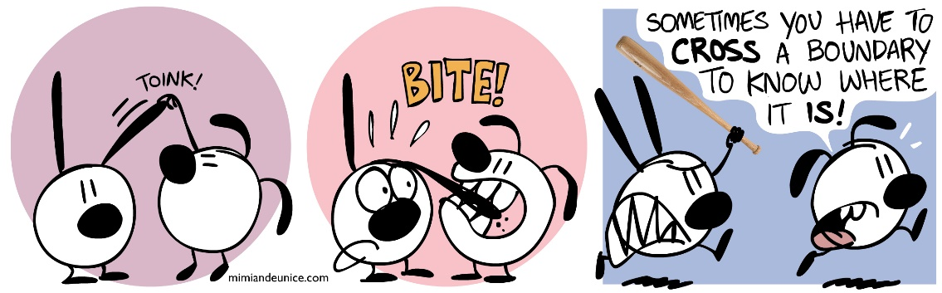
Section 2
Boundary Value Testing

Slide 37
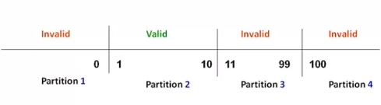
Boundary Value Testing (BVT)
Motivation: Experience indicates that, sometimes, programmers make mistakes in processing values at or near the boundaries of equivalence classes
Simpler but complementary to previous techniques
Example: Flight reservation app
What happens here?

Slide 38
Error at the Boundaries
Programmers make mistakes in processing values at and near the boundaries of equivalence classes
If (x<0) //Should have been If (x<=0)
M1();
Else
M2();
Equivalent Classes = (x<0 ; x>=0)
Tests = (x=-4, x=7)
Only x=0 (the boundary case) can reveal the bug!
In this example, the value x=0, lies at the boundary of the equivalence classes x≤0 and x>0

Slide 39
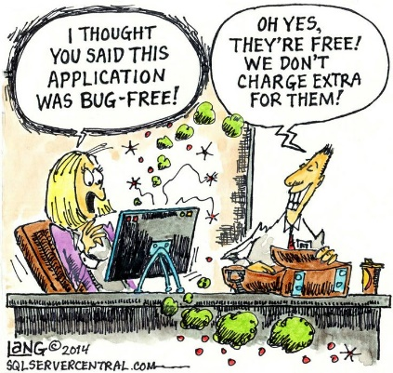
Boundary Value Analysis
While equivalence partitioning selects tests from within equivalence classes, boundary value analysis focuses on tests at and near the boundaries of equivalence classes
Tests derived using either of the two techniques may overlap
Boundary Value Testing (BVT) Approach: Select tests at or near boundary values

Slide 40
BVT: How to
For each equivalence class, setting values for input variable just below their min, at their min, just above the min, a nominal value, just below their max, at their max and just above their max
A typical strategy for all input variables: Holding the values of all but one variable at their nominal values, letting one variable take each of the above combinations
We can drop the BLB and AUB because they are out of the EC range
BLB : a value just below the lower bound
LB : the value on the lower boundary
ALB : a value just above the lower boundary
NOM : a nominal value
BUB : a value just below the upper bound
UB : the value on the upper bound
AUB : a value just above the upper bound
EC1
Robustness
testing
BLB LB ALB NOM BUB UB AUB
Notes:
In ECT we select one or more values from the range (nominal value) for each variable. In BVT we select them from the boundaries and close to boundaries.
There exist a tool integrated into case tools such as Software Through Pictures and Teamwork for boundary testing

Slide 41
BVT: Example
Assume a function F, with two variables x and y, domains X and Y
Boundaries: a <= x <= b, c <= y<= d
y
d
c
x
a
b

Slide 42
BVT: Example (cont’d)
Number of test cases=9
Test cases (TC) | x | y
1 | x_NOM | y_LB
2 | x_NOM | y_ALB
3 | x_NOM | y_NOM
4 | x_NOM | y_BUB
5 | x_NOM | y_UB
6 | x_LB | y_NOM
7 | x_ALB | y_NOM
8 | x_BUB | y_NOM
9 | x_UB | y_NOM
Y
d
c
a
b
X
LB ALB NOM BUB UB

Slide 43
BVT: Limitations
How many test cases is required for a function with n variables?
Works well with variables that represent bounded physical quantities
No consideration of the nature of the function and the meaning of variables
Simple technique that is amenable to robustness testing
Total 4n + 1 test cases
Later

Slide 44
Boundary Value Hints
Check if the boundary conditions for variables are set correctly
Check if the inequality boundary conditions can be changed to equality or not
Check if the counter variables allow departure from the loop correctly or not

Slide 45
Boundary Value Hints /1
Example (1):
If the program expects an upper case letter A-Z, Test @ (ASCII code just below the code for A) and [ (character just beyond Z)
Example (2):
If the program needs a specific number of inputs, give it that many, one more and one fewer

Slide 46
Boundary Value Hints /2
Example (3):
If a counter is set to have values:
0<i< 10, check if 0 and 10 are correct boundary values
Example (4):
When reading from or writing to a disk file, check the first and last character in the file

Slide 47
Example
Suppose we are testing a software module of an editor system that allows a user to enter new font identifiers into a font database. The input specification for the module states that a font identifier should
(i) consist of alphanumeric characters;
(ii) the range for the total number of characters is between 3 and 15; and,
(iii) the first two characters must be letters
When preparing test cases we will focus on selecting “equivalence classes” and “boundary values” for the inputs

Slide 48
Example (cont’d)
Identify input equivalence classes for this example
Spec. 1:
C1. Font name is alphanumeric, valid
C2. Font name is not alphanumeric, invalid
Spec. 2:
C3. Font identifier has between 3 and 15 characters, valid
C4. Font identifier has less than 3 characters, invalid
C5. Font identifier has greater than 15 characters, invalid
Spec. 3:
C6. The first 2 characters are letters, valid
C7. The first 2 characters are not letters, invalid
Notes:
Notice that we are not considering whether each character is a single (e.g. Ascii) or double (e.g. Asian) byte character because it is not part of the requirement.
Therefore be prepared to have the test case fail, even if all the conditions are satisfied, due to missing requirements.

Slide 49
Example (cont’d)
Identify boundary values for this example
BLB : a value just below the lower bound
LB : the value on the lower boundary
ALB : a value just above the lower boundary
NOM : a nominal value
BUB : a value just below the upper bound
UB : the value on the upper bound
AUB : a value just above the upper bound
For our example module the values for the bounds groups are:
BLB — 2 BUB — 14
LB — 3 UB — 15
ALB — 4 AUB — 16
NOM — anything between 4 and 14

Slide 50
Example (cont’d)
Typical set of test cases for this module based on the equivalence classes and boundary values
Case | Input values | Relevant Conditions | Pass/Fail criteria
1 | abc1 | C1; C3; C6; NOM | Pass
2 | ab1 | C1; C3; C6; LB | Pass
3 | abcdef123456789 | C1; C3; C6; UB | Pass
4 | abcde123456789 | C1; C3; C6; BUB | Pass
5 | 12* | C7 | Fail
6 | ¥©* | C2 | Fail
7 | ab | C4 | Fail
8 | abcdedgh1234567890 | C5 | Fail

Slide 51
BB Testing Variations
Robustness testing
Worst case testing
Category-partition testing
Decision tables
…
Model-based testing
Will be discussed later

Slide 52
Robustness Testing
In Robustness testing the BLB and AUB are also included in test cases
AUB
BLB
AUB
BLB

Slide 53
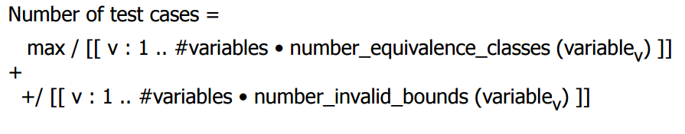
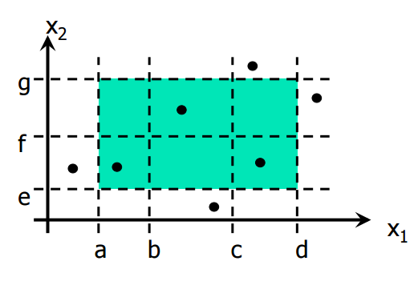
Weak-Robust ECT
Robustness
test

Slide 54
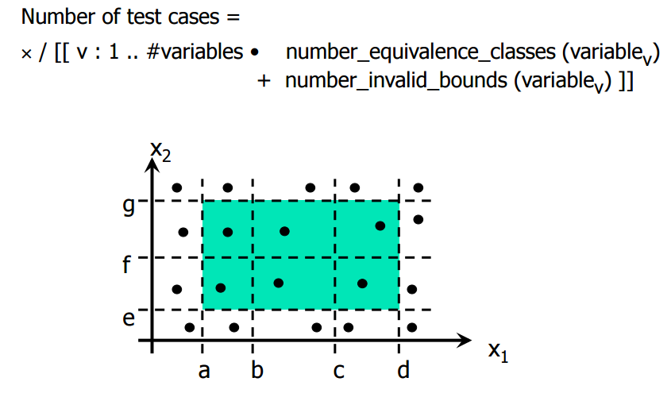
Strong-Robust ECT

Slide 55
Worst Case Testing (WCT)
Boundary value analysis makes the common assumption that failures, most of the time, originate from one fault related to an extreme value
What happens when more than one variable has an extreme value?
Idea comes from electronics in circuit analysis
Cartesian product of {LB, ALB, NOM, BUB, UB}
Clearly more thorough than boundary value analysis, but much more effort. How much?
5**n test cases
Good strategy when physical variables have numerous interactions, and where failure is costly

Slide 56
WCT for 2 Variables

Slide 57
Robust WCT for 2 Variables

Slide 58
Category-Partition Testing
Makes it easier to define special case categories
Combines boundary value analysis and equivalent classes with domain expertise
You can define constraints as well
Example: We have a text processing software product (T), developed totally within our software house. It must work with operating systems 1 and 2 and printer systems A, B, C, and D. What systems should we test?
Systems that represent all combinations of operating systems and printer systems with the text processing product: 1AT, 1BT, 1CT, 1DT, 2AT, 2BT, 2CT, 2DT and the product T itself. Some combinations may be illegal (i.e. can be ignored using domain expertise)

Slide 59
Section 3
Testing Using Decision Tables

Slide 60
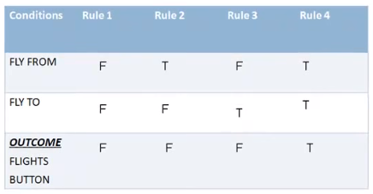
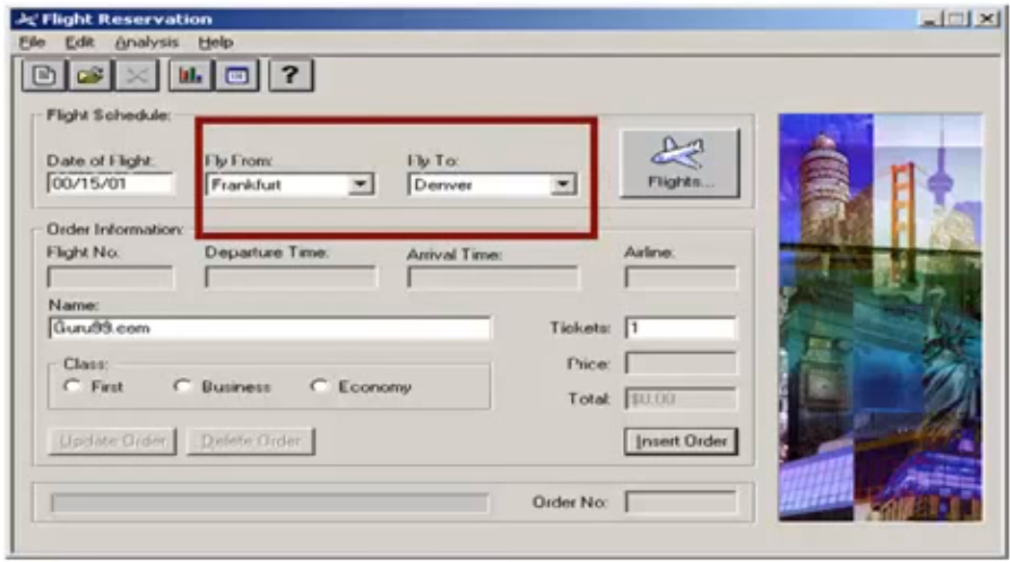
Decision Tables
Can help us deal with combination of inputs which produce different results
“FLY FROM” and “FLY TO” should be selected to allow the “flight button” become active
Some kind of
acceptance test

Slide 61
Testing Using Decision Table
The significance of this technique becomes immediately clear as the number of inputs increases
Number of possible combinations is given by 2**n , where n is the number of inputs
For n = 10, which is very common in the web based testing, having a typical fill form, the number of combinations will be 1,024
Obviously, some combinations are meaningless and/or you cannot test all but you will choose a rich sub-set of the possible combinations using decision based testing technique

Slide 62
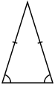
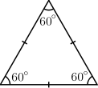
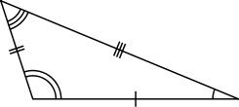
Testing Using Decision Table
Example
Let’s design a decision table for a program which needs to identify the type of a triangle given its edge (side) sizes
a
b
Equilateral | Isosceles | Scalene
c

Slide 63
Testing Using Decision Table
To help express test requirements in a directly usable form
Easy to understand and support the systematic and automated and derivation of test cases
Ideal for describing situations in which a number of combinations of actions are taken under varying sets of conditions, e.g., control systems

Slide 64
Decision Tables - Structure
There is a Condition section which lists conditions and their combinations
Conditions express relationships among decision variables
There is an Action section which lists responses to be produced when corresponding combinations of conditions are true
There will one test case for each test rule from the decision table
Q. Are we missing
conditions
a+b >c, etc. ?
Conditions
Decisions
Actions
rule
Notes:
64
It is not very effective to model memory as decision variables …. See state machine models
E.g.: credit line extension decision depends not only on current account characteristics and status but also on account history – more difficult to model with decision table
e.g.: a temperature control system using room temperature and user set temperature to control heating does not use history – easier to model with decision table
Input order may be important when inputs are event occurences, that have an order of arrival

Slide 65
Testing Using Decision Table
Converting decision tables to conventional truth table
If the condition block in our decision table has common Y/N (T/F) for many conditions, it is better to convert it to a conventional truth table
The triangle example, in the truth table, a “-” means “don’t care”
Notes:
Another way of representing the triangle decision table … less readable but possibly more adapted to cases with many conditions
Directly exploitable for test case generation
Refinement of the first condition here: 3 conditions for “ a, b, c are a triangle?”
11 categories of test cases: total coverage -> minimum of 11 test cases

Slide 66
Testing Using Decision Table
One test case for each test rule from the corresponding truth table
“?”: cannot provide test data (i.e., the test case is impossible to execute)
Test cases…
(?)
(?)
(?)
A test rule (test cases)
11 test cases…
Notes:
We obtain 11 test cases: three impossible cases (?), three ways to fail the triangle property, one way to get an equilateral triangle, one way to get a scalene triangle, and three ways to get an isosceles triangle
Impossible cases cannot be entered by the user (obviously) but may be the result of a bug in the condition implementations. The system may still need to be robust to it and detect it.

Slide 67
Example: Decision Table
Bank account transaction processing
Conditions (total 4):
Does the named person hold the credit card entered, and is the other information correct?
Is it still active or has it been cancelled?
Is the person within or over their limit?
Is the transaction coming from a normal or a suspicious location?
Actions:
Should we approve the transaction?
Should we call the cardholder (e.g., to warn them about a purchase from a strange place)?
Should we call the vendor (e.g., to ask them to seize the cancelled card)?

Slide 68
Example: Decision Table
Decision table for 4 conditions (2**4=16 cases)
Conditions | 1 | 2 | 3 | 4 | 5 | 6 | 7 | 8 | 9 | 10 | 11 | 12 | 13 | 14 | 15 | 16
Real account? | Y | Y | Y | Y | Y | Y | Y | Y | N | N | N | N | N | N | N | N
Active account? | Y | Y | Y | Y | N | N | N | N | Y | Y | Y | Y | N | N | N | N
Within limit? | Y | Y | N | N | Y | Y | N | N | Y | Y | N | N | Y | Y | N | N
Location okay? | Y | N | Y | N | Y | N | Y | N | Y | N | Y | N | Y | N | Y | N
Actions
Approve? | Y | N | N | N | N | N | N | N | N | N | N | N | N | N | N | N
Call cardholder? | N | Y | Y | Y | N | Y | Y | Y | N | N | N | N | N | N | N | N
Call vendor? | N | N | N | N | Y | Y | Y | Y | Y | Y | Y | Y | Y | Y | Y | Y
Collapse

Slide 69
Example: Decision Table
Collapsing decision table: combining columns
How?
Conditions | 1 | 2 | 3 | 5 | 6 | 7 | 9
Real account? | Y | Y | Y | Y | Y | Y | N
Active account? | Y | Y | Y | N | N | N | -
Within limit? | Y | Y | N | Y | Y | N | -
Location okay? | Y | N | - | Y | N | - | -
Actions
Approve? | Y | N | N | N | N | N | N
Call cardholder? | N | Y | Y | N | Y | Y | N
Call vendor? | N | N | N | Y | Y | Y | Y
Notes:
To combine two or more columns, look for two or more columns that result in the same combination of actions. Note that the actions must be the same for all of the actions in the table, not just some of them. In these columns, some of the conditions will be the same, and some will be different. The ones that are different obviously don’t affect the outcome. So, we can replace the conditions that are different in those columns with the dash character (“-”). The dash usually means either I don’t care, it doesn’t matter, or it can’t happen, given the other conditions.

Slide 70
Section 4
Combinatorial Testing

Slide 71
Combinatorial Testing
Assumption: a main cause of software failure is interaction faults, specially in mission critical systems
Combinatorial testing do
Combine values systematically but not exhaustively
Rationale: Most unplanned interactions are among just two or a few parameters or parameter characteristics
Look for interactions (or semantics) of the inputs

Slide 72
Combinatorial Testing
Typical examples
System Configuration: Software applications are often designed to work in a variety of environments. Combinations of factors such as the operating system, network connection, and hardware platform, lead to a variety of environments. Each environment corresponds to a given set of values for each factor, known as a test configuration.
Software Configuration: Set up options
Control room operation: control room of a
powerplant involves hundreds of switches
that can be set manually
Notes:
Other examples: Web interfaces; on-line examination; architectural floor planning, etc.

Slide 73
Combinatorial Testing
There are 10 effects, each can be On or Off
All combinations is 2¹⁰ = 1,024 tests
What if our budget is too limited for these tests?
The weak approach: test each effect independently:
10 effects 1-2 tests each →
total 10-20 tests → too weak?
A middle ground?
Let’s look at t-way interactions
Why not testing 2- or 3- or t- of them together?
Pairwise (2-way) testing finds about 50% to 90% of flaws

Slide 74
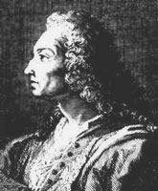
Combinatorial Testing
If a set has n elements, the number of t-way independent combinations is equal to the binomial coefficient
In this example, number of 3-way interactions
Naively, 120 x 2³ = 960 tests
Not much saved then 1024 vs. 960!
Jakob Bernoulli (1645-1705)

Slide 75
Combinatorial Testing
But we can design tests wiser to not test duplicate triples
Each test exercises many triples:
Since we can pack 3 triples into each test, we need no more than (960/3)=320 tests
The smallest number of tests we need

Slide 76
Terminology
k factors (parameters/configurations)
t interactions (strength)
pair-wise → t=2 t-way testing
l levels (possible values for each factor, e.g. binary)
Covering array: CA(k,t,l)
A set of concrete test cases that covers all t-way interactions among the k factors with all combinations of l levels of values

Slide 77
Minimum Set Covering Array
Each row is a test, each column is a parameter
All triples in only 13 tests, covering 960 combinations
Unfortunately, finding minimum covering arrays is NP hard
Notes:
Figure above gives an example of a covering array for all 3-way interactions of 10 binary parameters (columns) in only 13 tests (rows). It can be seen that any three columns chosen out of ten columns, contain all eight possible values of the three parameters: 000,001,010,011,100,101,110,111.

Slide 78
NIST’s Covering Array Tool

Slide 79
Example
A system with 34 on-off switches
2³⁴ = 1.7 x 10¹⁰ possible inputs tests
What if we know no failure involves more than 3 switch settings interacting?
3-way interactions, need only 33 tests
4-way interactions, need only 85 tests

Slide 80
Combinatorial Testing
If all faults are triggered by the interaction of t or fewer variables, then testing all t-way combinations can provide strong assurance
In FDA medical devices, the most complex failure reported required 4-way interaction to trigger
In avionics software applications maximum interactions for fault triggering has been 6
If all faults are triggered by the interaction of t or fewer variables, then testing all t-way combinations can provide strong assurance

Slide 81
Section 5
Profile-based Testing

Slide 82
Definition: Profile
Profile for a phenomenon is a set of disjoint alternatives called “elements” or “features” that represent that phenomenon together with their occurrence probabilities.
Example:
If alternative A occurs 30% of time; B occurs 20% of time and C occurs 50% of time, the profile is
A 0.3
B 0.2
C 0.5

Slide 83
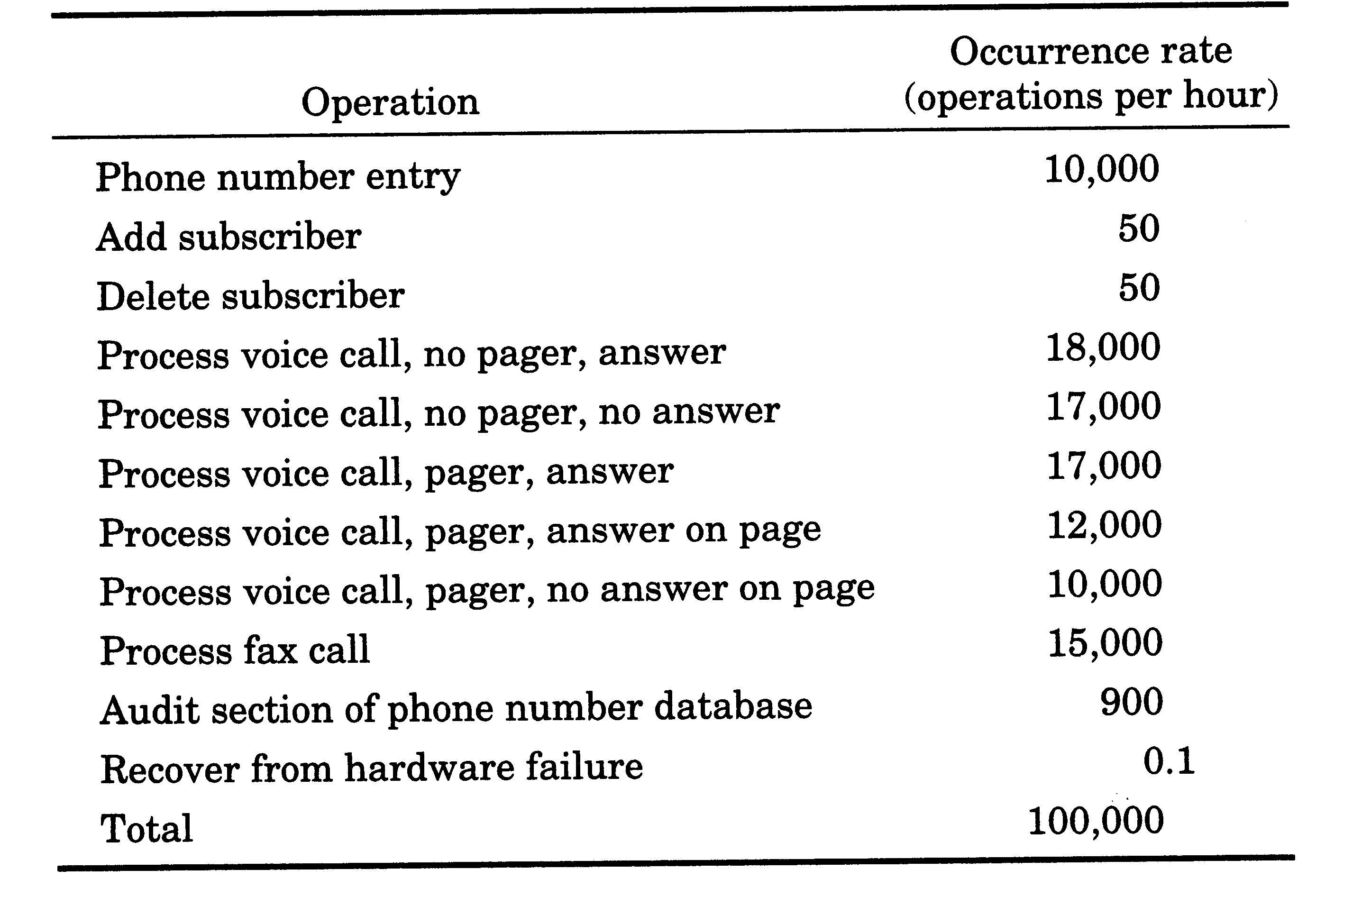
Definition: Operational Profile
Example:
Operational Profile is the set of operations (operation names and frequencies) and their probabilities of occurrences
Example From Musa’s book

Slide 84
Representation
Representing Operational Profile:
Tabular representation
Graphical representation

Slide 85
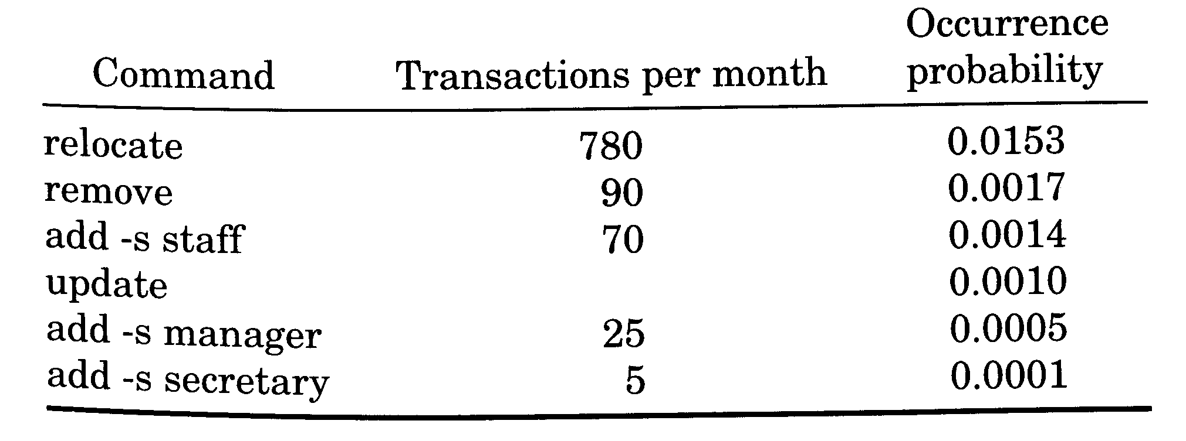
Representation: Tabular
Tabular representation is composed of a list of operation names and their probability of occurrence.
Table from Reliability Engineering Handbook

Slide 86
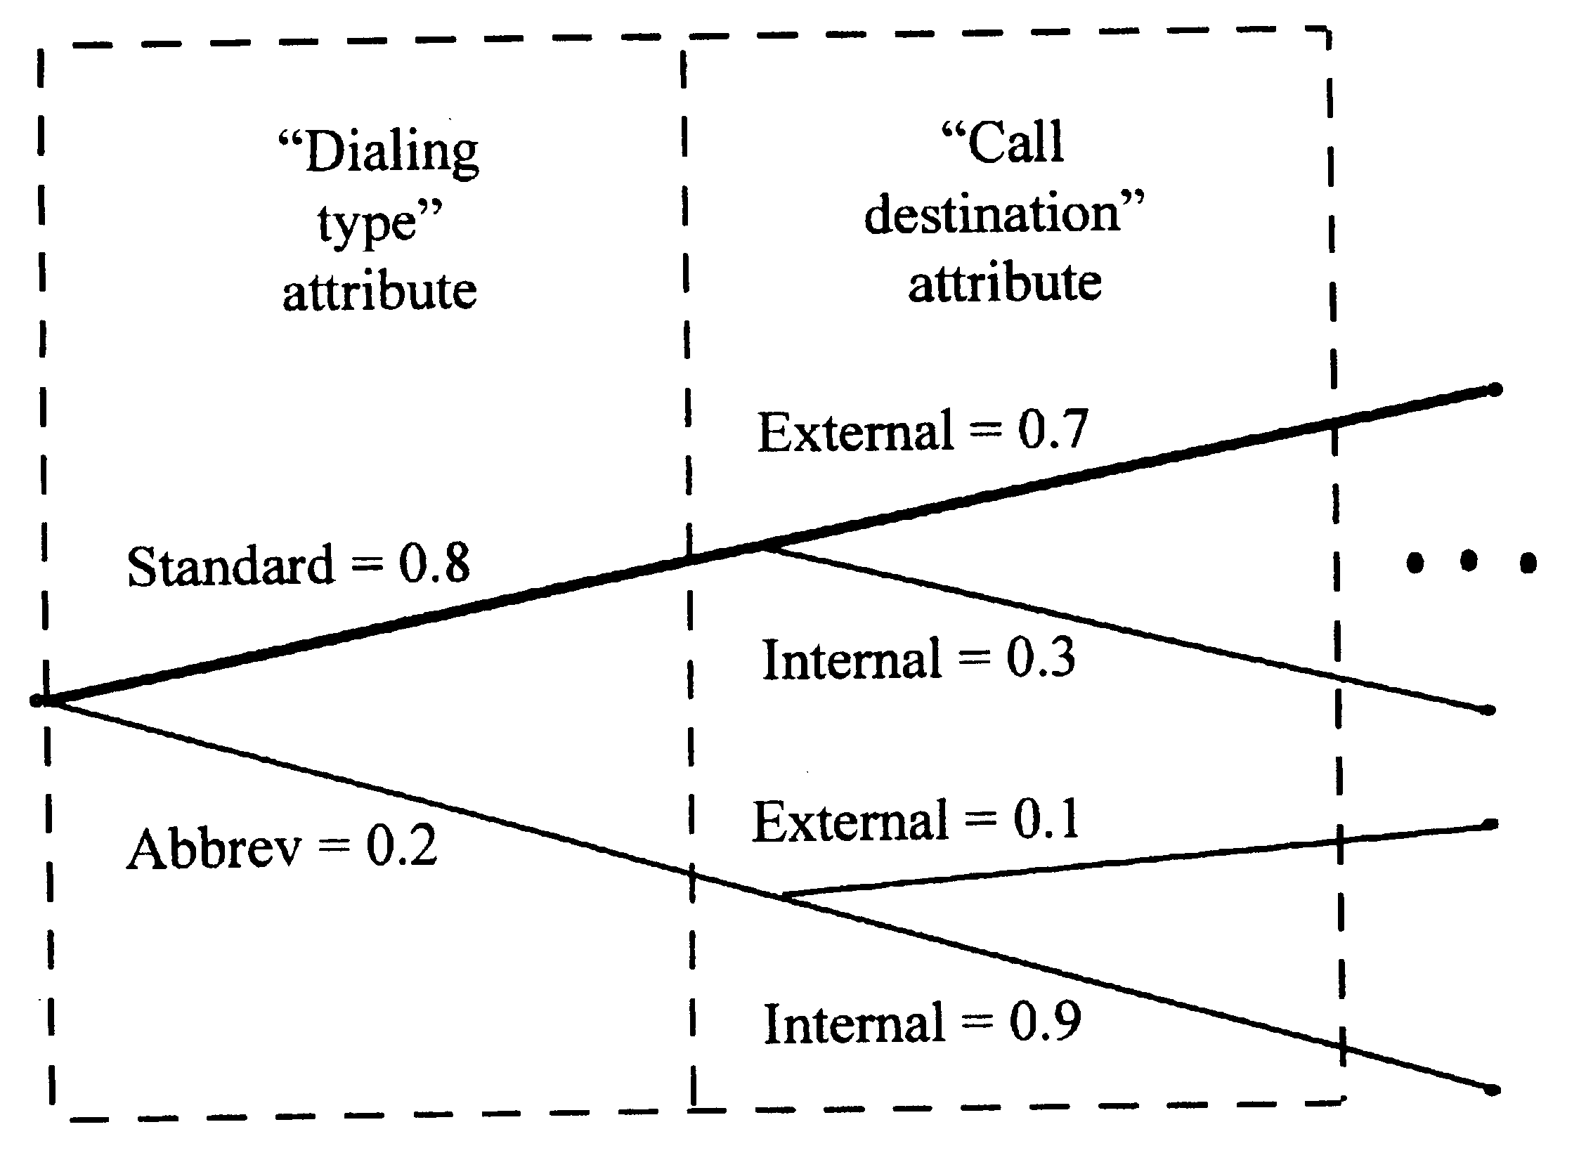
Representation: Graphical
Graphical representation is composed of
Nodes: attributes of operations
Branches: values of attributes
Occurrence probability: associated with the branches
Graphical representation can be generated from tabular representation and vice versa.
Figure from Musa’s book

Slide 87
Example 1
An embedded software system has been developed for a VCR system. The system has 5 functions, namely: Stop (STOP) – Rewind (REWIND) – Play (PLAY) – Fast Forward (FF) and Record (REC). We want to create an operational profile for this VCR system in order to test the above 5 functions. The following table shows the usages scenario of each function depending on the starting state (rows) data that has been collected through analysis of customers’ behaviour. The 5 functions are shown in the columns. Create the operational profile for this system.
Functions Initial state | STOP | REWIND | PLAY | FF | REC
Standby | 0 | 0.20 | 0.50 | 0.20 | 0.1
Rewind | 0.30 | 0 | 0.60 | 0.10 | 0
Play (counter < 15000) | 0.50 | 0.30 | 0 | 0.20 | 0
Fast forward | 0.50 | 0.10 | 0.40 | 0 | 0
Record | 1 | 0 | 0 | 0 | 0
Play (counter >=15000) | 0.80 | 0.15 | 0 | 0.05 | 0

Slide 88
Example 1
Operational profile for the VCR system
Functions Initial state | STOP | REWIND | PLAY | FF | REC
Standby | 0 | 0.20 | 0.50 | 0.20 | 0.10 | Sum
Rewind | 0.30 | 0 | 0.60 | 0.10 | 0
Play (counter < 15000) | 0.50 | 0.30 | 0 | 0.20 | 0
Fast forward | 0.50 | 0.10 | 0.40 | 0 | 0
Record | 1 | 0 | 0 | 0 | 0
Play (counter >=15000) | 0.8 | 0.15 | 0 | 0.05 | 0
SUM | 3.10 | 0.75 | 1.50 | 0.55 | 0.10 | 6
Normalize | 0.517 | 0.125 | 0.250 | 0.092 | 0.016 | 1
Test resources should be distributed among the programs operating the buttons based on their relative usage weights
Note: Criticality of operation/function may be considered, too

Slide 89
Example 2
An embedded software system has been developed for an elevator system
The system has several operations, namely: UP (to go up) – DOWN (to go down) – HOLD OPEN (hold the doors open) and HOLD CLOSE (hold the doors closed)
The user can also select the touch panel number 1-10 to select the floor he/she wants to go, in combination with the above buttons
We want to create an operational profile for this system in order to test the above operations

Slide 90
Example 2
The following table shows the usage scenario of each operation depending on the starting state (rows) data that has been collected through analysis of customers’ behaviour
The operations are shown in the columns. For every row, the total probability is one
For passengers waiting outside the elevator:
Functions Initial state of the elevator | UP | DOWN
Standby | 0.5 | 0.5
Occupied; moving up; current location upper floors | 0.9 | 0.1
Occupied; moving down; current location upper floors | 0.1 | 0.9
Occupied; moving up; current location lower floors | 0.9 | 0.1
Occupied; moving down; current location lower floors | 0.1 | 0.9

Slide 91
Example 2
For passengers inside the elevator:
Functions Initial state of the elevator | Select floor 1 to 10 | HOLD OPEN | HOLD CLOSE
Standby | 0.9 | 0.05 | 0.05
Occupied; moving up; current location any | 0.8 | 0.1 | 0.1
Occupied; moving down; current location any | 0.8 | 0.1 | 0.1

Slide 92
Example 2
Create test profile for this system by combining the two tables
Functions Initial state of the elevator | UP | DOWN | Select floor 1 to 10 | HOLD OPEN | HOLD CLOSE
Standby | 0.5 | 0.5 | 0.9 | 0.05 | 0.05
Occupied; moving up; upper floors | 0.9 | 0.1 | 0.8 | 0.1 | 0.1
Occupied; moving up; lower floors | 0.9 | 0.1 | 0.8 | 0.1 | 0.1
Occupied; moving down; upper floors | 0.1 | 0.9 | 0.8 | 0.1 | 0.1
Occupied; moving down; lower floors | 0.1 | 0.9 | 0.8 | 0.1 | 0.1
SUM | 2.5 | 2.5 | 4.1 | 0.45 | 0.45 | Sum 10
profile | 0.25 | 0.25 | 0.41 | 0.045 | 0.045 | 1
Test resources should be distributed among the programs operating the buttons based on their relative usage weights

Slide 93
Conclusions
Black Box partitioning techniques give us a
Systematic approach to identify values to be tested per input/feature
And couple of potential ways to combine them (weak/strong/robust, etc.)
But ... test suite size grows very rapidly with number of categories
Can we use a non-exhaustive approach?
Pairwise (and t-way) combinatorial, category-partitions and profile based testing do

